Slide 1
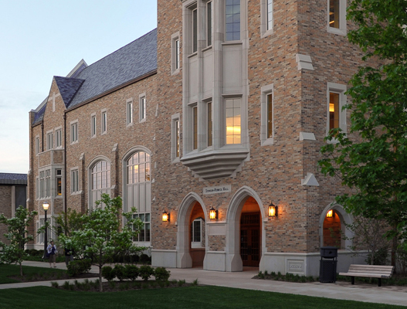
Midwest Imaging & Microanalysis Workshop at Notre Dame
New Trends in In-Situ and High Resolution Electron Microscopy for Nano-technology, Materials and Bio-Sciences
May 8, 2018
All students, faculty and industrial colleagues are welcome to attend!
Workshop location:
The University of Notre Dame
McKenna Conference Center
Rooms 210 - 214
Notre Dame Avenue
Notre Dame, IN 46556
Participation is free, but a reservation is required. Please, make your reservation by April 9, 2018 by completion of Registration form on the NDIIF Website or email to imaging@nd.edu
May 8th: Lectures by experts from leading Electron Microscopy Companies (Thermo Fisher Scientific, Bruker, Gatan, Oxford and Protochips), Midwest Universities (University of Notre Dame, Purdue University, University of Michigan, University of Illinois - Urbana-Champaign), as well as International Universities (University of Glascow) and Argonne National Laboratories
There will also be a Student Poster Session with cash prizes.
May 9 – Tours of NDIIF Facilities
For more information and updates, visit: imaging.nd.edu

